Slide 1
Felsenstein & the birth of statistical phylogenetics

Slide 2
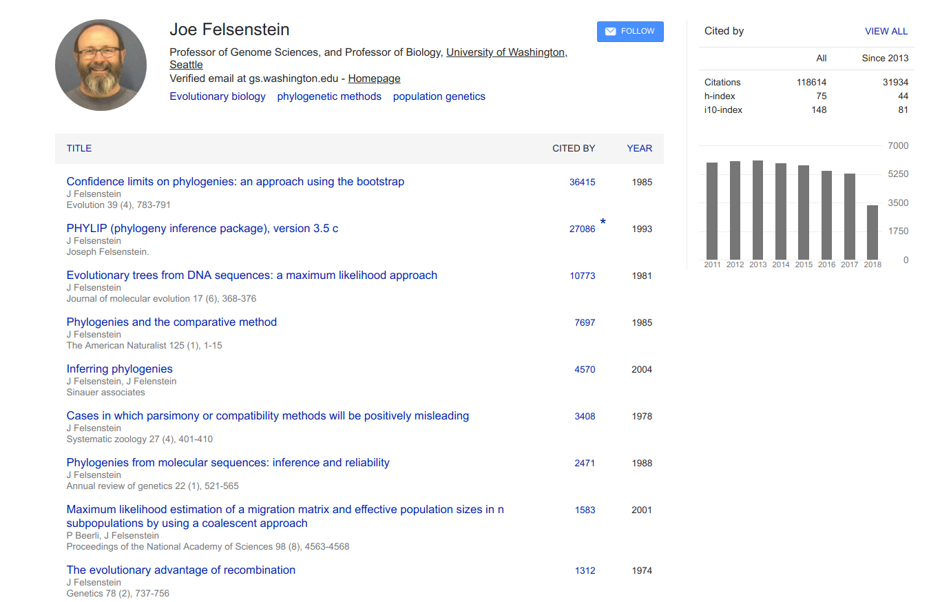

Slide 3
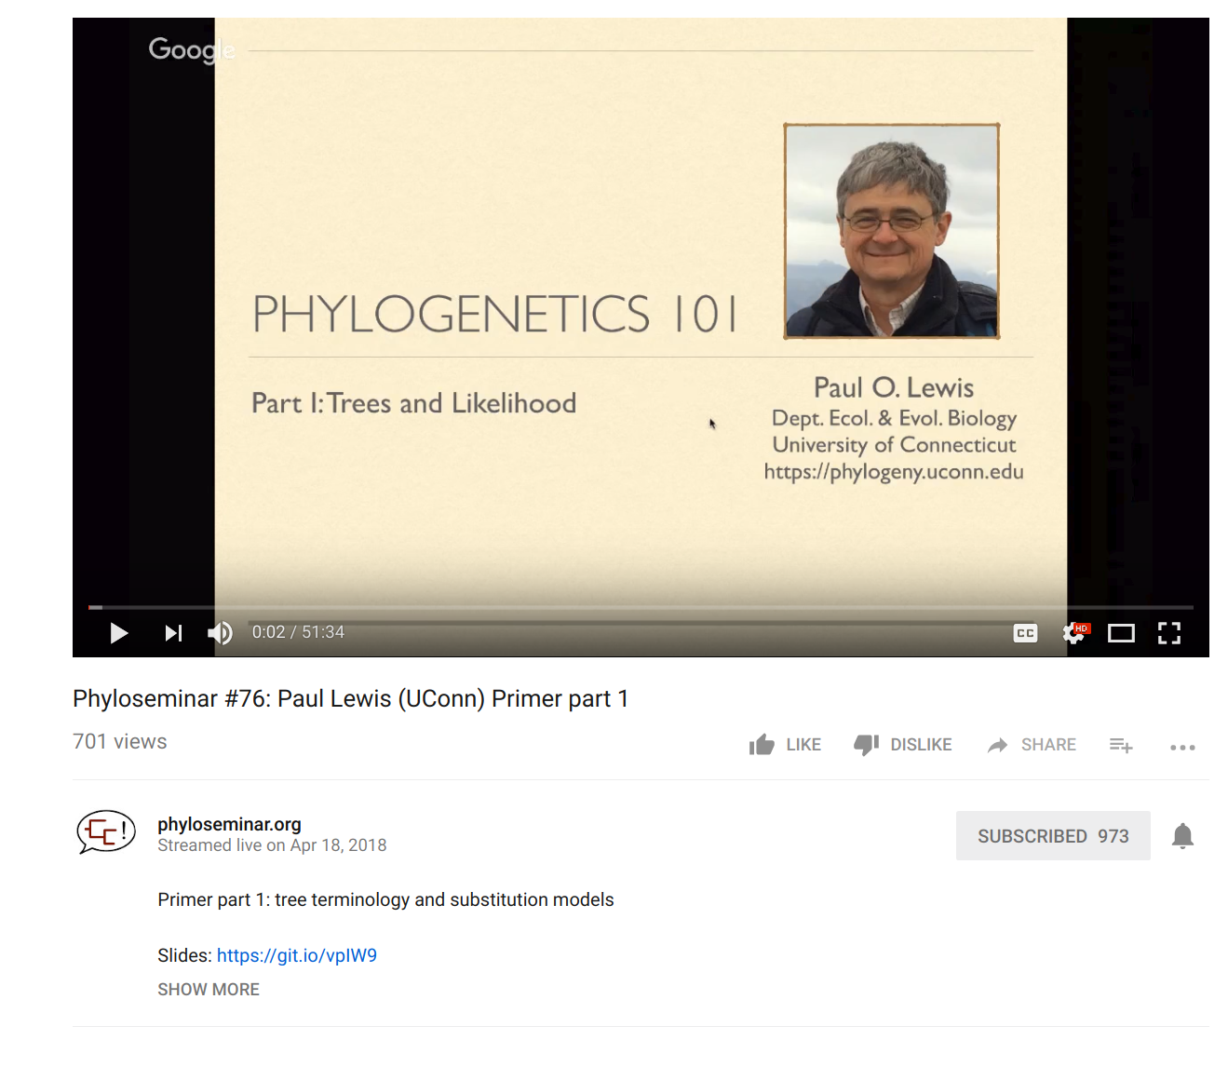
Full disclaimer: I'm borrowing some of this material from Paul Lewis (Uconn) (Check out his teaching materials!)

Slide 4
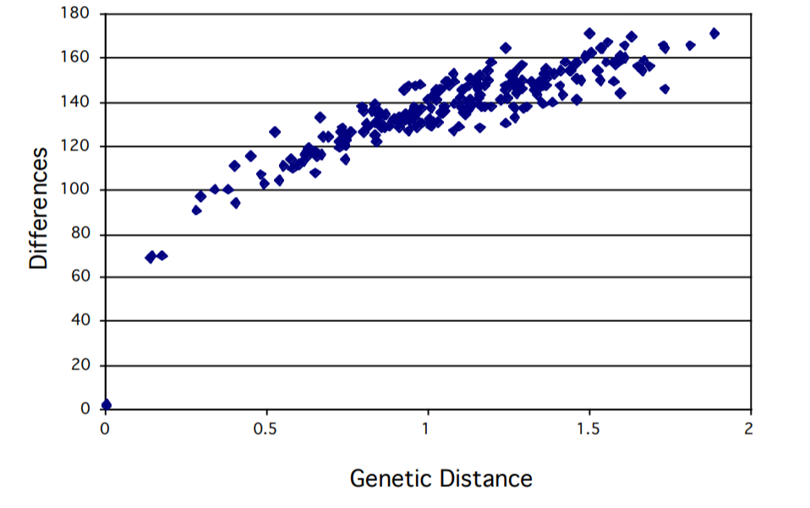
Why do we need statistics?

Slide 5
If two sequences are unrelated, what % of bases do you expect to be identical?
A. 50%
B. 25%
C. 0%
D. I need more information

Slide 6
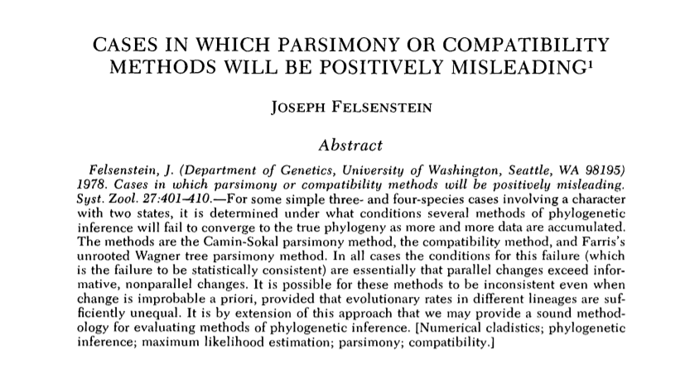
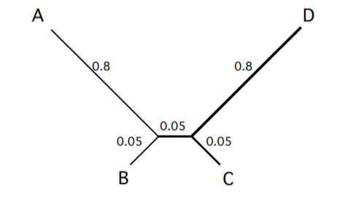
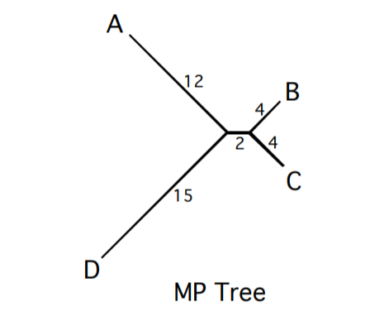
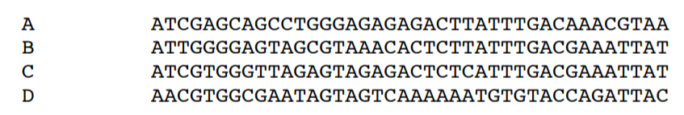
"Long-branch attraction"

Slide 7
P( | )
P( | )

Slide 8


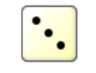
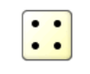
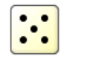
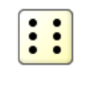
How do we treat trees probabilistically?
If these come up, change state
If these come up, stay the same

Slide 9
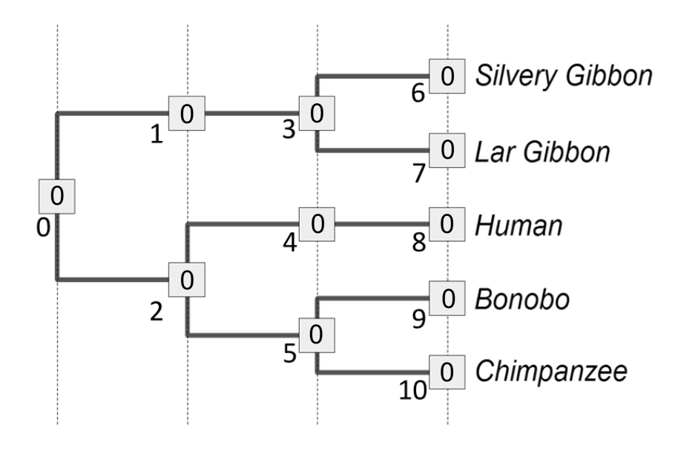

Slide 10
0

Slide 11
0
0

Slide 12
0
0
0

Slide 13
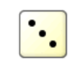
0
0
0
0
0

Slide 14
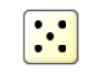
0
0
0
0
0
0

Slide 15
0
0
0
0
0
0
1

Slide 16

0
0
0
0
0
0
0
1

Slide 17

0
0
0
0
0
0
0
1
1
1

Slide 18
0
0
0
0
0
0
0
0
1
1
1

Slide 19
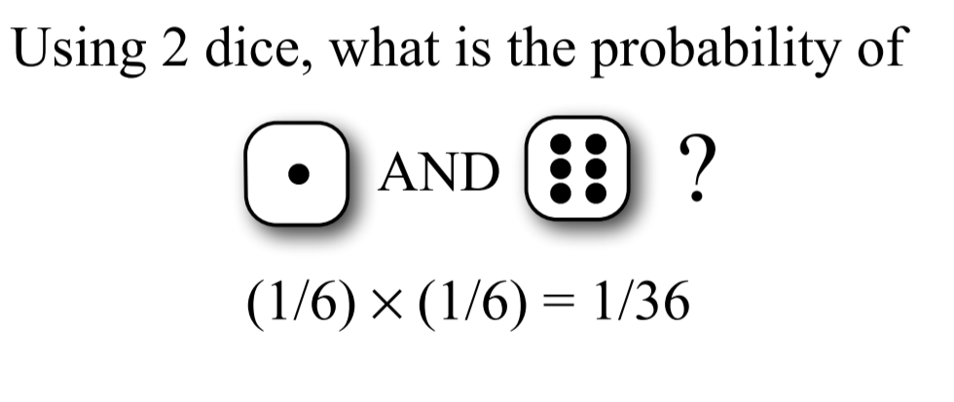
Combining probabilities: The AND rule
If two independent events occur, multiply their individual probabilities to get the full probability of an event

Slide 20
Combining probabilities: The AND rule in phylogenetics
0
0
0
0
0
0
0
0
1
1
1
Likelihood(D, N_{i}|T₁)* = (4/6)⁹ x (2/6)¹=0.0087

Slide 21
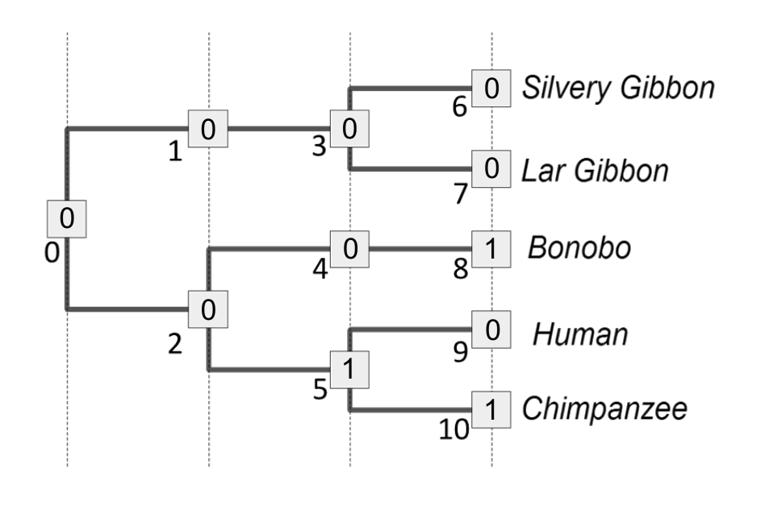
Combining probabilities: The AND rule in phylogenetics
0
0
0
0
0
0
1
0
0
0
1
Likelihood(D, N_{j}|T₂)* = (4/6)⁸ x (2/6)²=0.0043

Slide 22
0
0
0
1
1

Slide 23
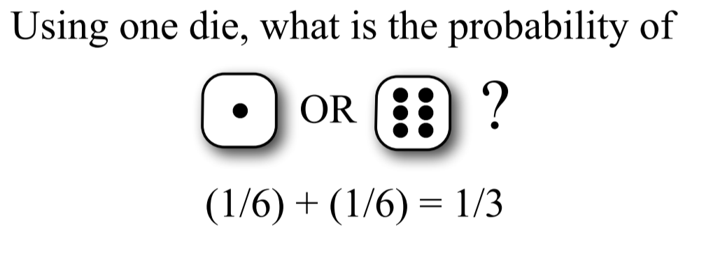
Combining probabilities: The OR rule
Two mutually exclusive probabilities should be ADDED together to get the total probability of the two events

Slide 24
Combining probabilities: The OR rule in phylogenetics
0
0
1
0
1
1
0
0
1
0
1
Likelihood (D, N_{k}|T₁) = (4/6)⁰ x (2/6)¹⁰=0.000017

Slide 25
Combining probabilities: The OR rule in phylogenetics
0
0
1
0
1
1
0
0
1
0
1
Likelihood (D, N_{k}|T₁) = (4/6)⁰ x (2/6)¹⁰=0.000017

Slide 26
There are 2⁶ = 64 possible node assignments. We could calculate the likelihood of each one, then sum them together, to get the total L(Data | Tree₁).
0
0
0
1
1

Slide 27
We used discrete time units. Biology will want continuous time
Markov assumption = probability of change depends only on current state, not how long it has been in that state

Slide 28
Continuous-Time Markov Models

Slide 29
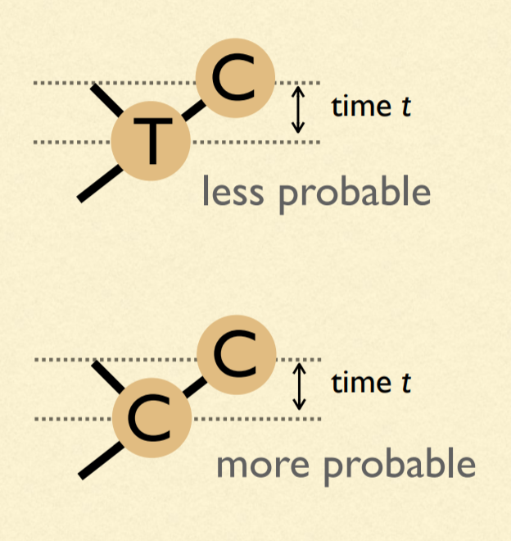
Our model of change depends on time: We must estimate branch lengths
Units of branch length will be expected number of substitutions per site
(= rate of substitions x time)

Slide 30
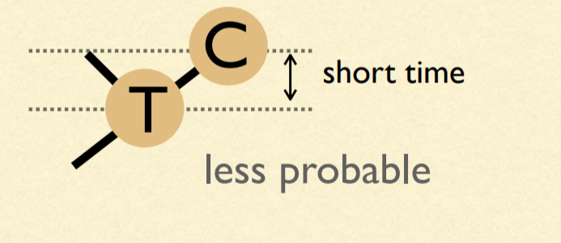
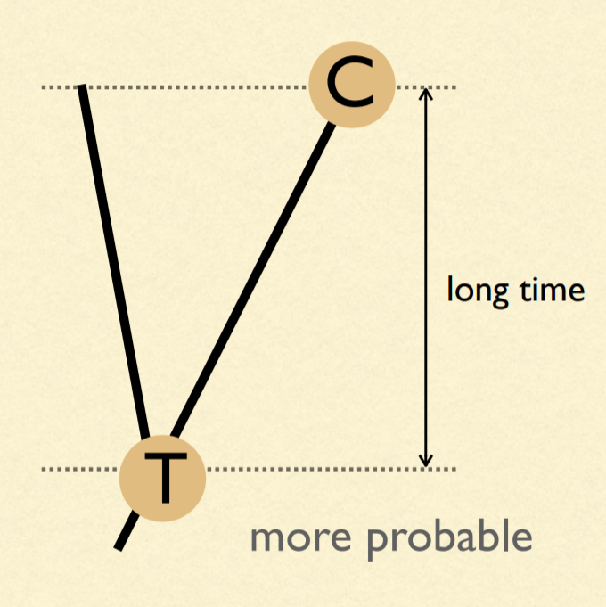
Probabilities are dependent on time

Slide 31
μ = 4β
A
β
β
β
β
A
T
G
C

Slide 32
A (very) simple phylogeny...
time
A
A
P_{AA} =
Probability nothing happened +
Probability something happened, but that the last thing that happened ended in an A

Slide 33
A (very) simple phylogeny...
time
A
A
P_{AA} = (e^{-μt} ) + (1 - e^{-μt})(1/4)
Probability something doesn't happen
Probability at least one thing happens
Probability that the last thing that happened ends in an A

Slide 34
A (very) simple phylogeny...
time
A
G
P_{AG} = (1 - e^{-μt})(1/4)
Probability at least one thing happens
Probability that the last thing that happened ends in an G

Slide 35
A (very) simple phylogeny...
time
A
C
P_{AC} = (1 - e^{-μt})(1/4)
Probability at least one thing happens
Probability that the last thing that happened ends in an C

Slide 36
A (very) simple phylogeny...
time
A
T
P_{AT} = (1 - e^{-μt})(1/4)
Probability at least one thing happens
Probability that the last thing that happened ends in an T

Slide 37
One last bit...substitutions vs. "events"
ν = (3/4)μt = 3βt
4ν/3 = μt
Only 3 out of 4 events results in a substitution. Thus, we can define the substitution rate ν.

Slide 38
P_{AA} = (e^{-μt} ) + (1 - e^{-μt})(1/4)
P_{AG} = (1 - e^{-μt})(1/4)
P_{AC} = (1 - e^{-μt})(1/4)
P_{AT} = (1 - e^{-μt})(1/4)

Slide 39
P_{AA} = (1/4) + (3/4)(e^{-4ν/3} )
P_{AG} = (1/4) - (1/4)(e^{-4ν/3})
P_{AC} = (1/4) - (1/4)(e^{-4ν/3})
P_{AT} = (1/4) - (1/4)(e^{-4ν/3})
Sanity check: Do they all add to 1?

Slide 40
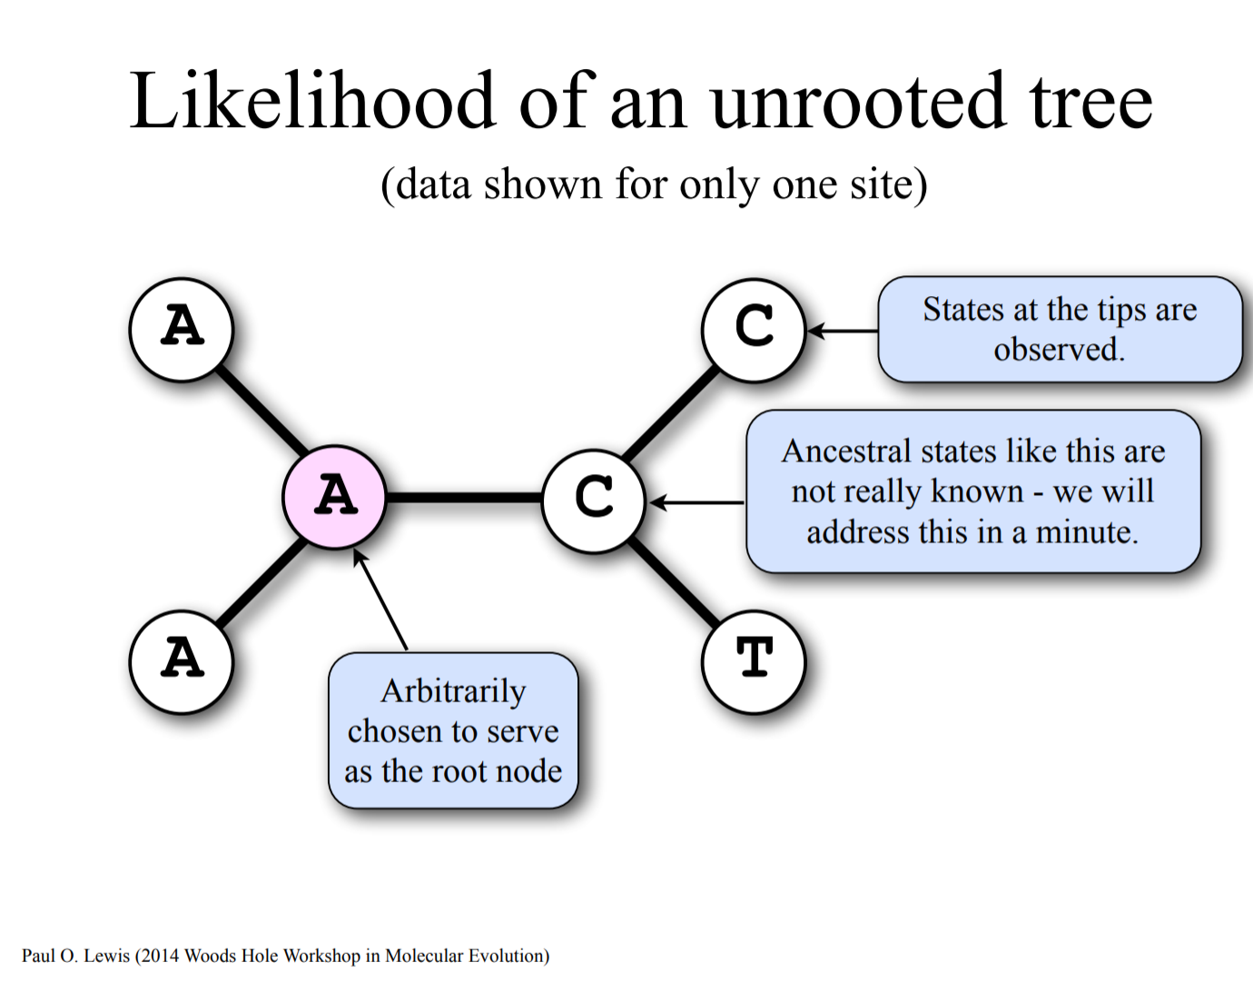

Slide 41
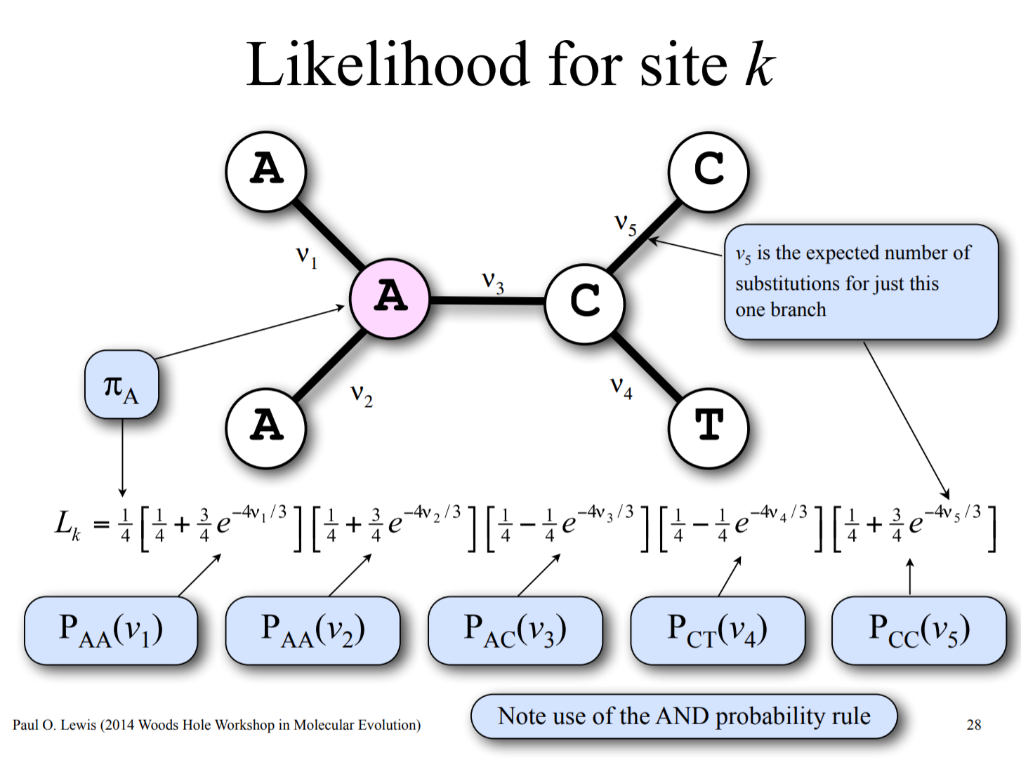

Slide 42
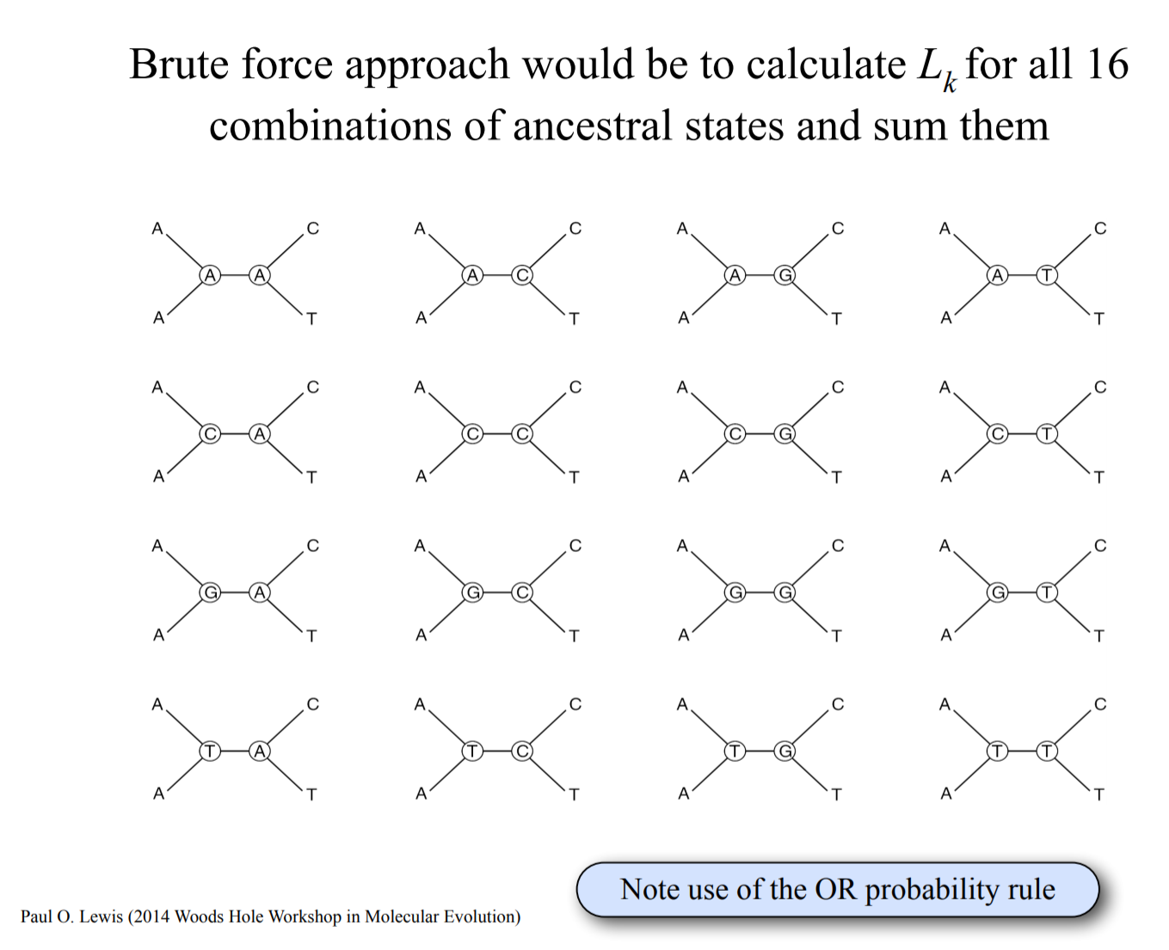

Slide 43
Pruning algorithm

Slide 44
Pruning algorithm

Slide 45
Pruning algorithm

Slide 46
Pruning algorithm

Slide 47
Pruning algorithm

Slide 48
Pruning algorithm

Slide 49
Pruning algorithm

Slide 50
Pruning algorithm

Slide 51
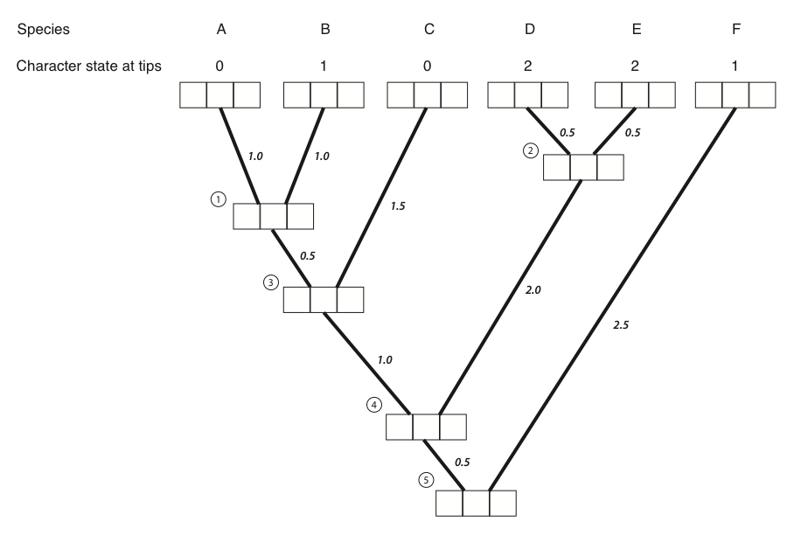
1 0 0
0 1 0
1 0 0
0 0 1
0 0 1
0 0 1

Slide 52
1 0 0
0 1 0
1 0 0
0 0 1
0 0 1
0 0 1
0.12 0.12 0.1

Slide 53
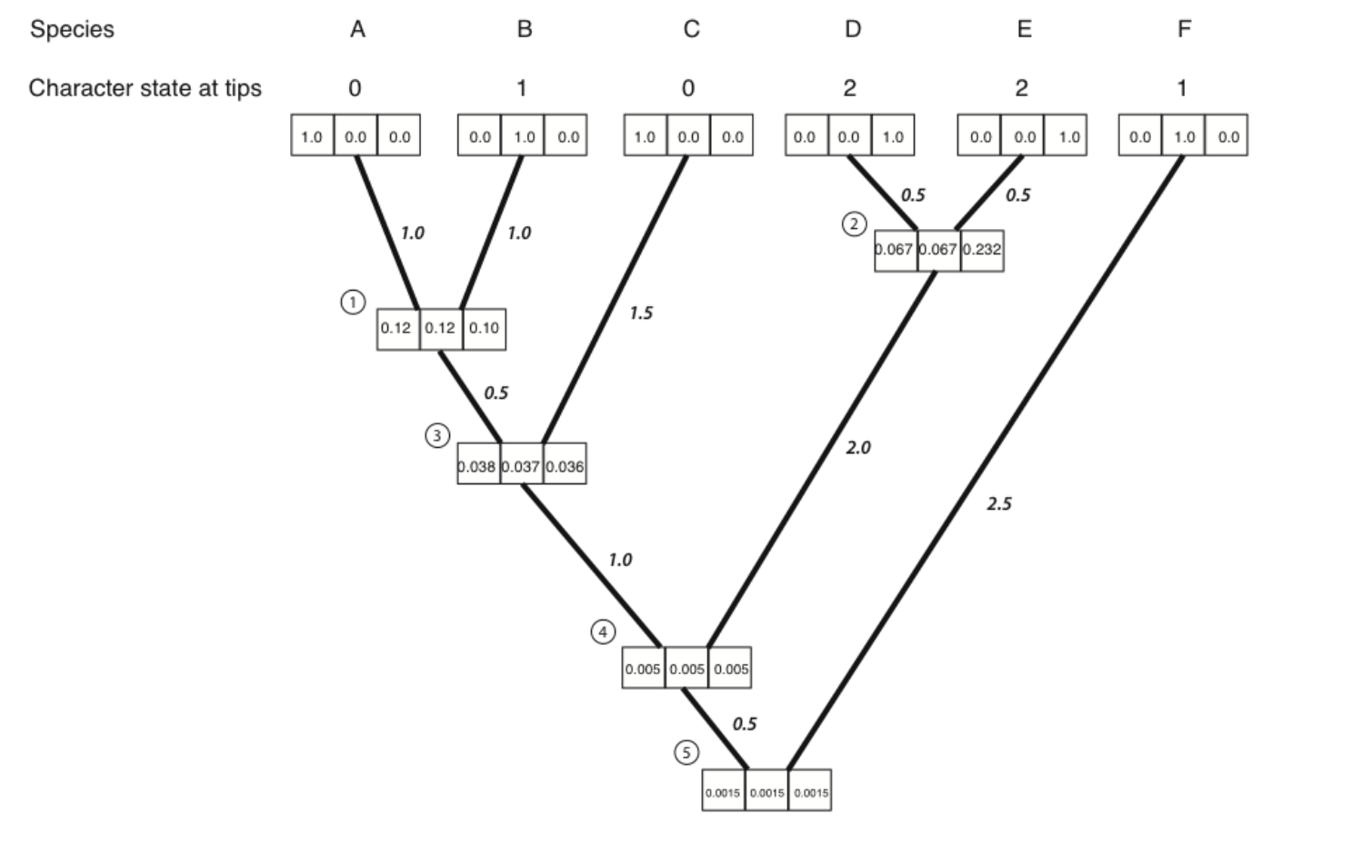

Slide 54
Jukes-Cantor Model (JC69)
Q matrix (instantaneous rates)
A C G T
A -3β β β β
C β -3β β β
G β β -3β β
T β β β -3β
Q =

Slide 55
Jukes-Cantor Model (JC69)
Transition probabilities:
P = e^{Qt}
Matrix exponentiation

Slide 56
JC69 is our most basic model. We will be able to do amazing things with generalizations of this one model!
A C G T
A - β β β
C β - β β
G β β - β
T β β β -
Q =

Slide 57
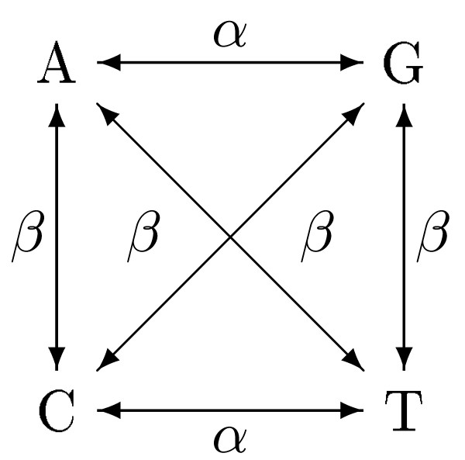
Kimura 2 Parameter model: K2P
A C G T
A - β α β
C β - β α
G α β - β
T β α β -
Q =

Slide 58
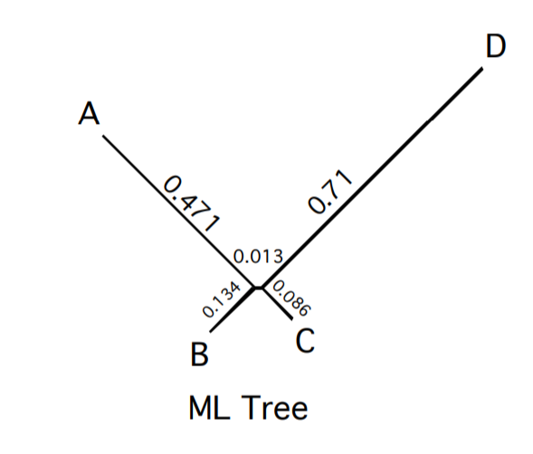
Returning to our original problem:
True Tree

Slide 59
Differences between statistical phylogenetics and parsimony
We get branch lengths in expected number of changes rather than minimum # of changes
We expect and probabilistically incorporate all possible paths to the data, not just the shortest path
We have the flexbility to modify and compare models
We have a straight-forward way to convert branch lengths to time (with fossils or other constraints)
We use ALL OF THE DATA, not just parsimony-informative sites

Slide 60
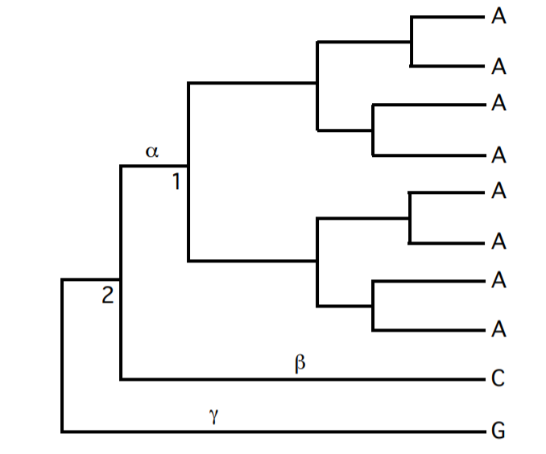
Example: Parsimony says node 2 can be either A, C, or G with equal number of steps.

Slide 61
Example: Likelihood will say that node 2 is most likely A. Why?

